Slide 1
CS699 Project Presentation: Redfin Housing Listings
Authors: Mike Zhong
Jan Alleman
4/22/20

Slide 2
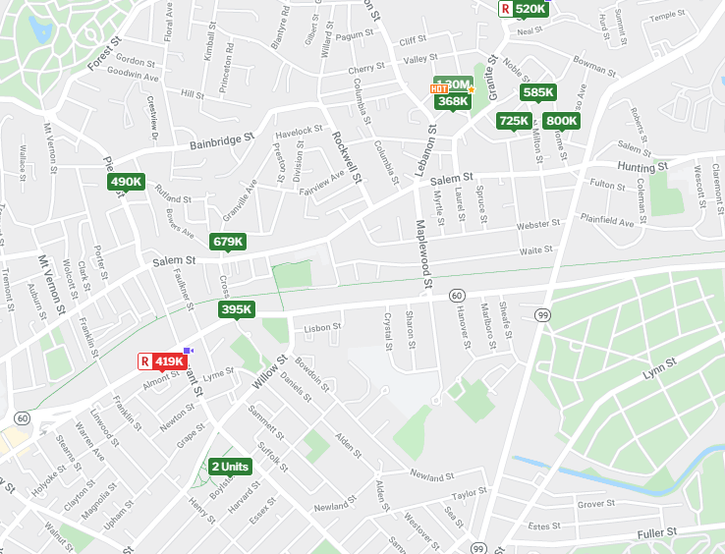
The Data Source
Redfin.com is a popular website that aggregates real estate listings.
Redfin allows for complex querying of the available listings and also allows for downloading queries into csv format

Slide 3
The Raw Data Set
A query was performed to get all listings in the MA area (a few from RI snuck in)
27 attributes, 350 tuples

Slide 4
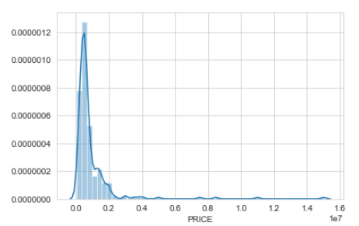
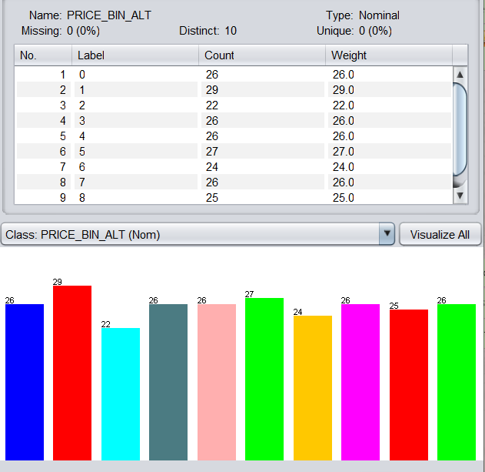
Project Goals
Our goal is to predict appropriate list prices for new houses going on the market based on their properties
The list price is a continuous variable and we need to discretize it into a “Class Attribute” with equal depth binning.
Price in 10 million $

Slide 5
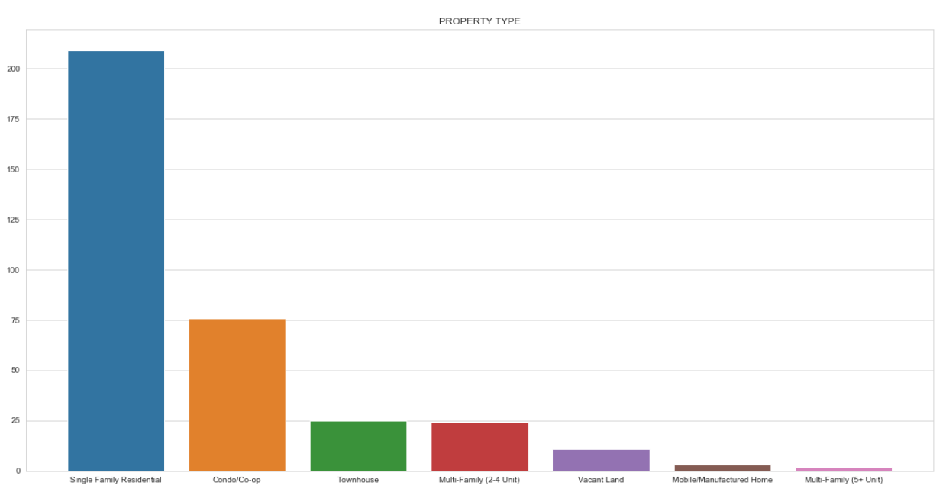
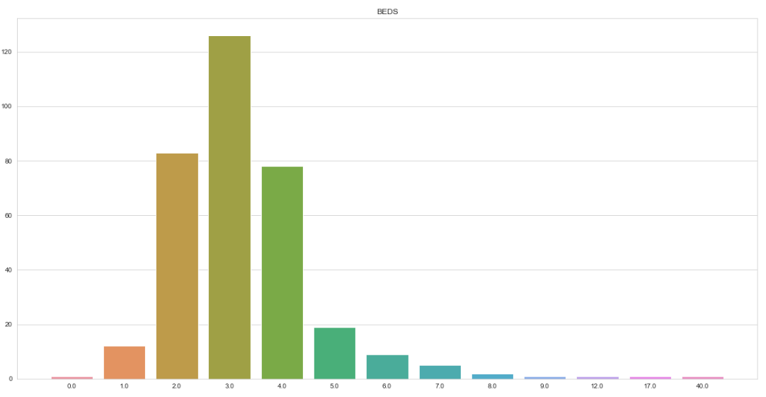
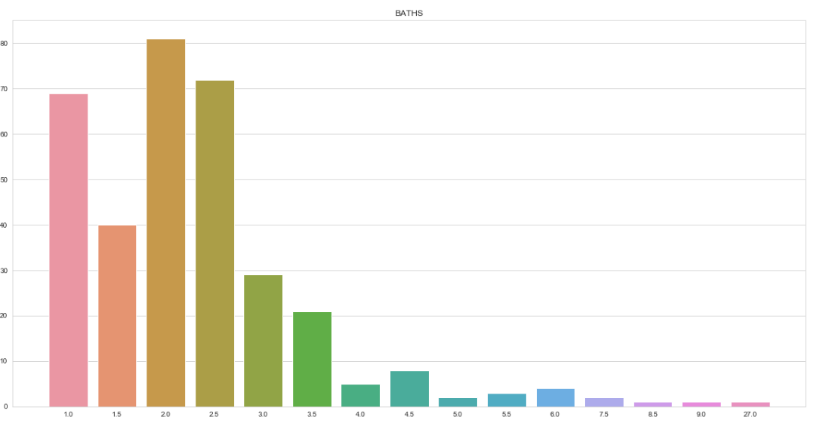
Data Exploration/Pre-processing
Property Type
Beds
Baths
Valuable information about the properties
Numeric attributes

Slide 6
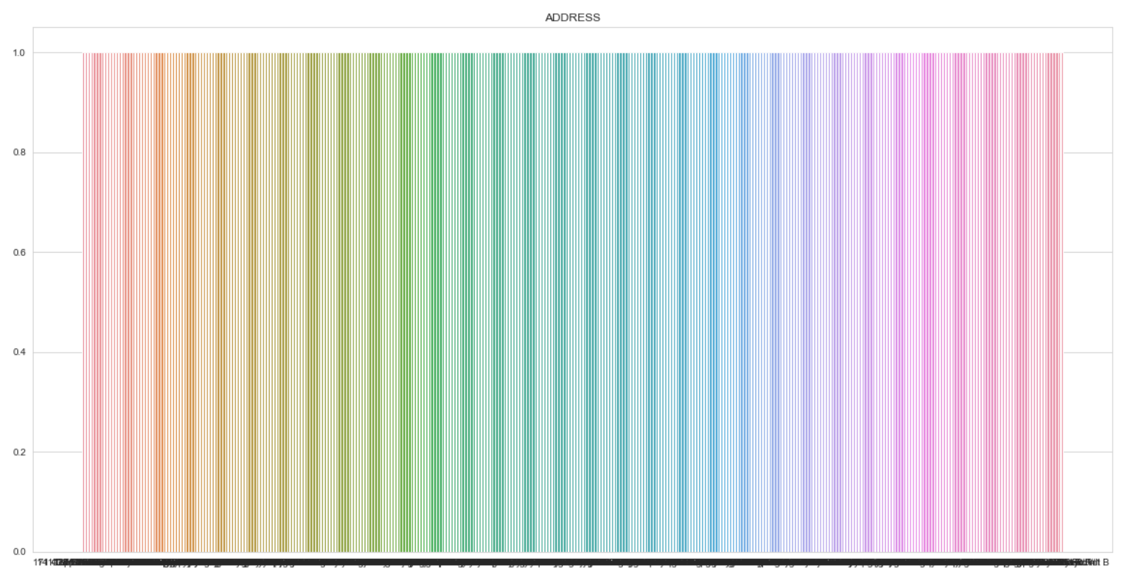
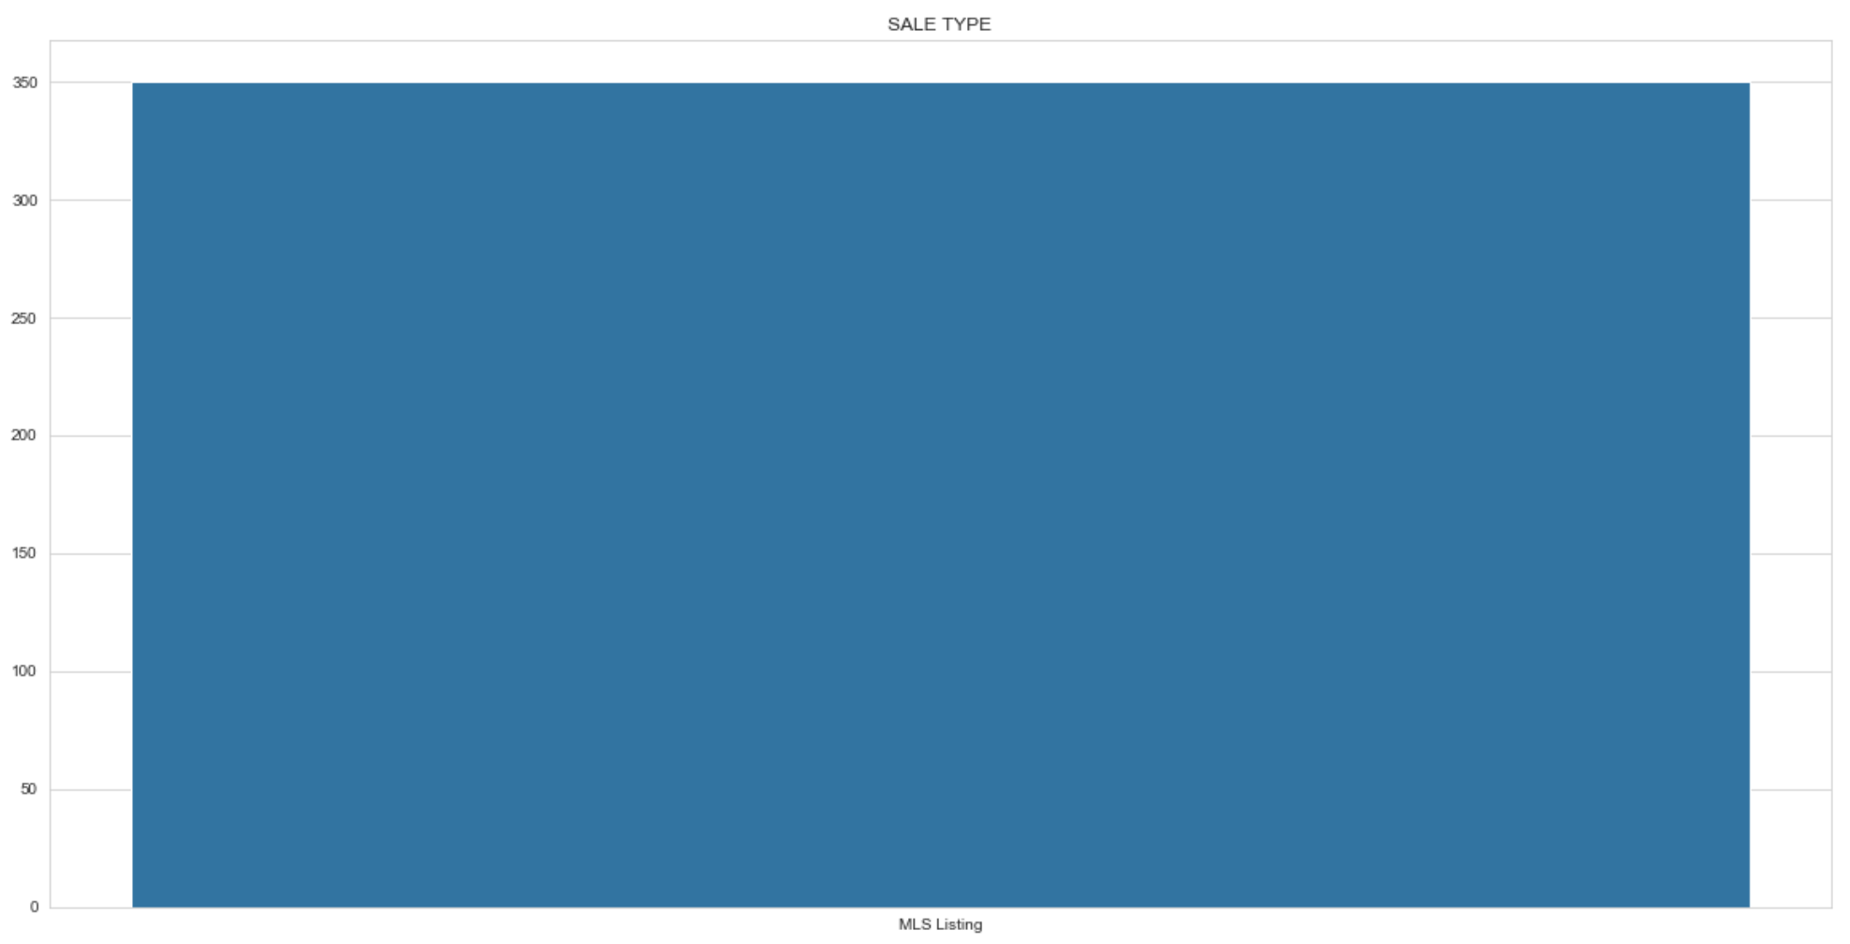
Data Exploration/Pre-processing
Address
Sale Type
Certain attributes could be filtered out immediately
Avoid overfitting
Any fields not related to the actual physical characteristics of the land/additions were dropped

Slide 7
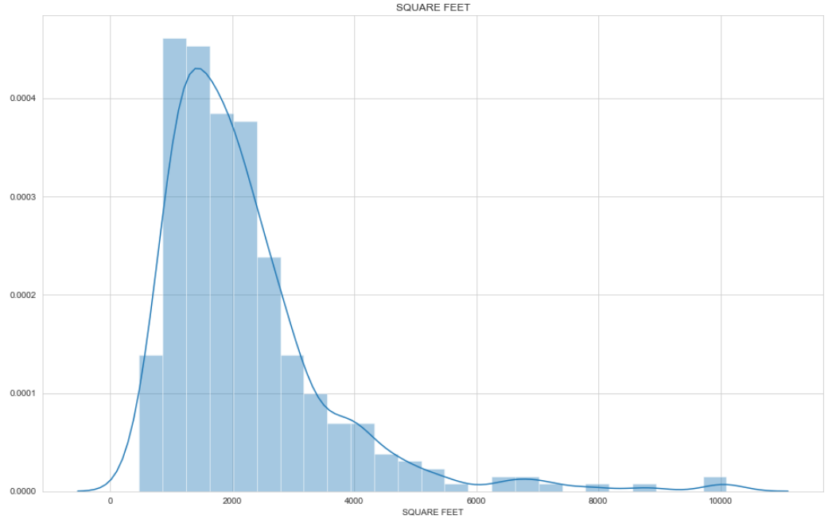
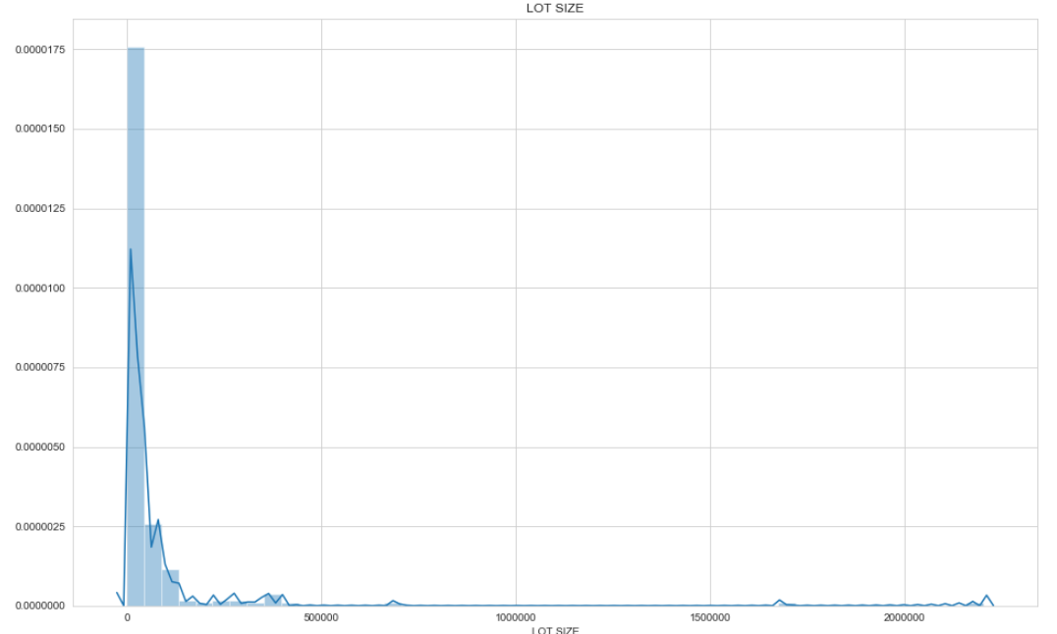
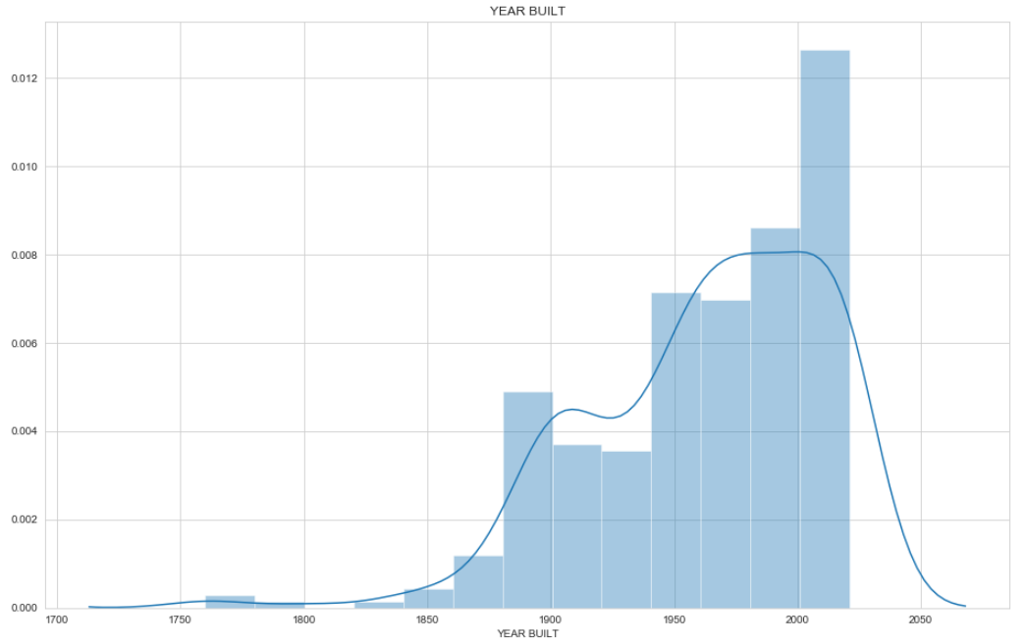
Missing Data/Outlier handling
SQUARE FEET
LOT SIZE
YEAR BUILT
*note this outlier

Slide 8
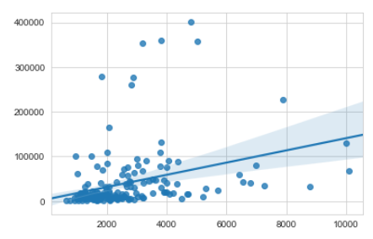
Missing Data/Outlier handling
Several pre-processing steps were taken before the data were ready to actual analyze
HOA fee was set to 0 when NaN
One property had a lot size of 1682722 and was a clear outlier so it was dropped
Several properties were missing either lot size of square footage. If a property was missing both, it was dropped. Otherwise, a linear regression model relating lot size to square feet was produced using listings with both and used to interpolate the missing data
LOT SIZE = 4561.77 + 13.63*(SQUARE FEET)
Recalculate $/sq ft using the new interpolated values
lot size
square feet

Slide 9
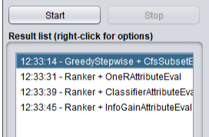
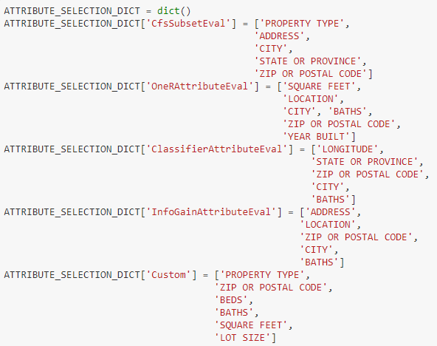
Attribute Selection in Weka
Four attribute selection methods were chosen from the Weka Explorer.
The top 5 attributes from each attribute selection method were chosen for model building.
Our own custom attribute selection method was based purely on heuristics

Slide 10
Classification Models Tested
5 data mining algorithms are chosen to model on each of the 5 subsets described in chapter 5.
⇨ RandomForestClassifier
⇨ MLPClassifier
⇨ GradientBoostingClassifier
⇨ LogisticRegression
⇨ DummyClassifier
The combination of the data mining algorithm and attribute selection methods leads to 25 different models. The following pages show detailed results of all the 25 models.
The F-score takes both TP as well as FP into account and is considered as the most meaningful measure. The best model is therefore chosen based on the F-score.
The OneR Attribute Selection Method performs best in average.
The RandomForest Data Mining algorithm performs best in average
The combination from Classifier Attribute Selection and RandomForest performs best out of all models.

Slide 11
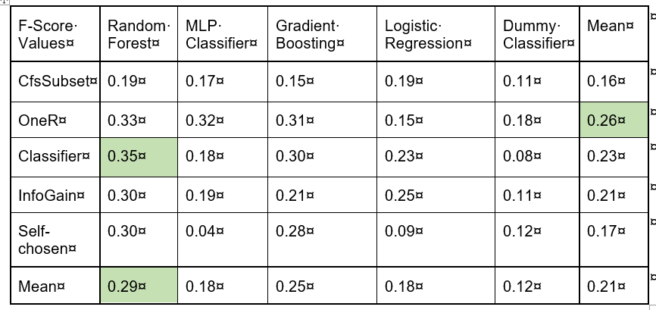
Classification Models Compared

Slide 12
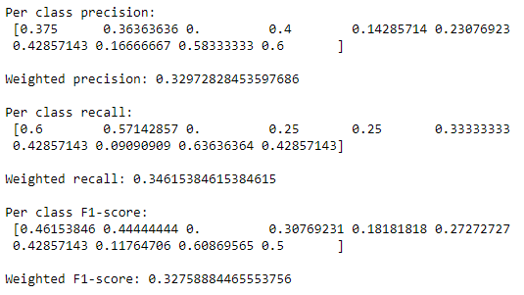
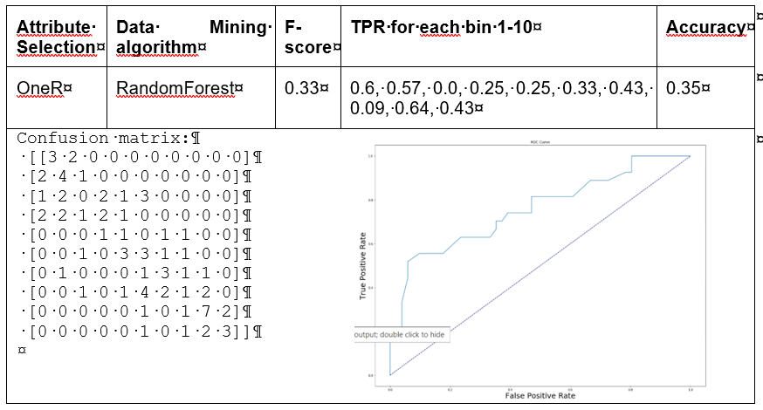
The Best Performing Model
The OneR Attribute selection method with the Random Forest performed best

Slide 13
Conclusions and Future Opportunities
In conclusion, none of the attribute selection methods and models performed very well. This is likely a result of missing insights in the input data set
A lot of attributes were dropped
Lack of understanding in outliers
Possible opportunities for improvement:
Better curate the data or partition the data and train one model per property type
Tune model hyperparameters
Spend more time optimizing one model rather than training a bunch
Applications:
A trained model could easily be exported as pickle file and a tool developed which would give seller’s a suitable price range to list their house at based on the attributes of their lot and property.
Realistically, several models would need to be trained or a real-time training process would occur where houses similar to the one being sold are used for training

